Slide 1
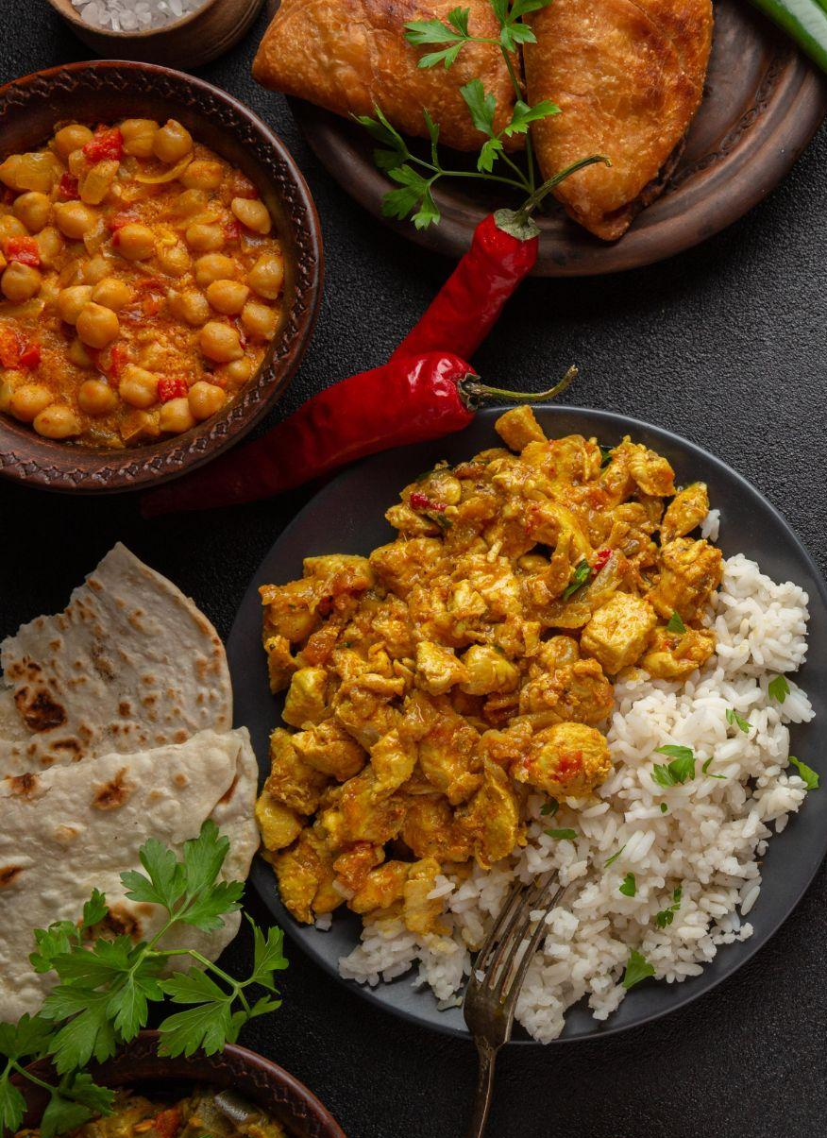
Indian Restaurant Business Plan
DATA ANALYTIC PROCESS
By: Shilpi Soni

Slide 2





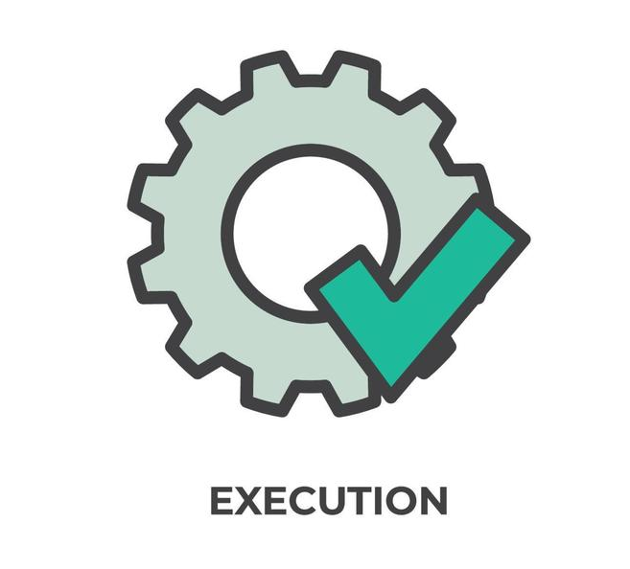
Table of contents
01
02
03
04
05
06
PLAN
PREPARE
PROCESS
ANALYSIS
SHARE
ACT

Slide 3

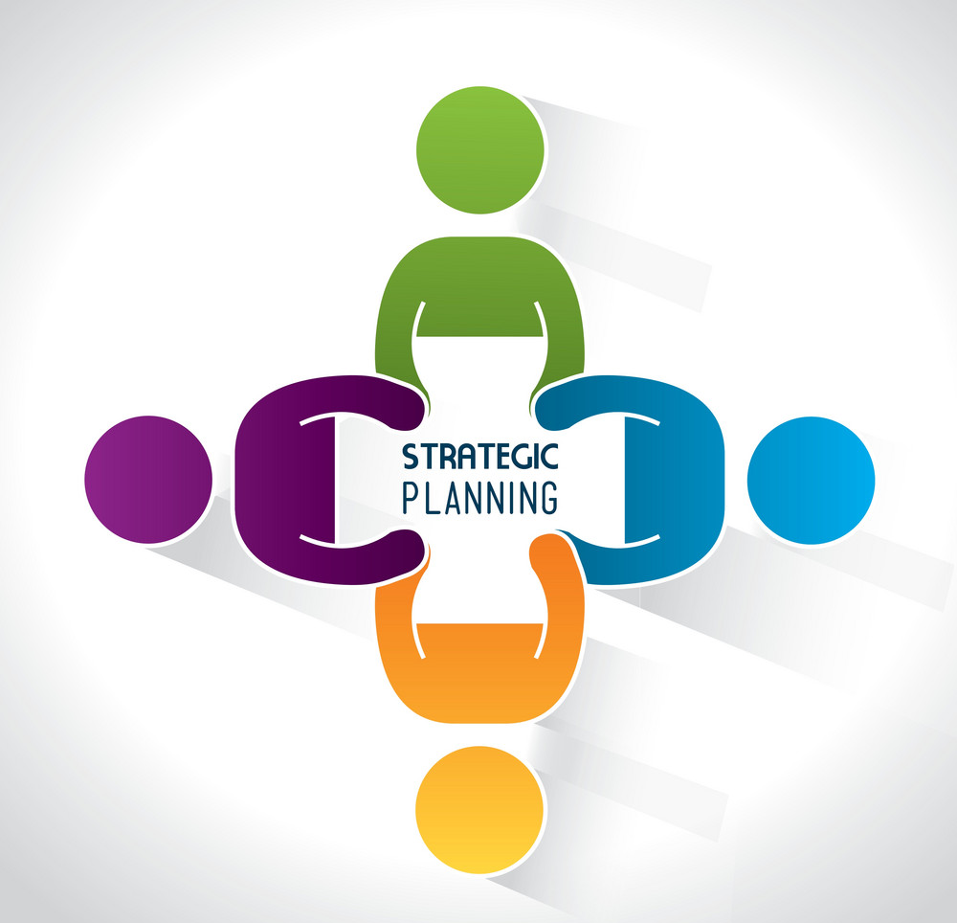
PLANNING
Name and Concept of restaurant
Budget
Location
Get significant licenses
Workforce
Design a stellar menu
Marketing & Advertisement

Slide 4

PREPARE
Use different online resources to prepare a business plan for the restaurant. Ex: google, chat gpt
Evaluate all restaurant costs involved
Decide the location of your restaurant.
Get all licenses required to start a restaurant business.
Get manpower for your restaurant business.
Connect to social platform for marketing & advertisement
Ex: Instagram, Facebook

Slide 5
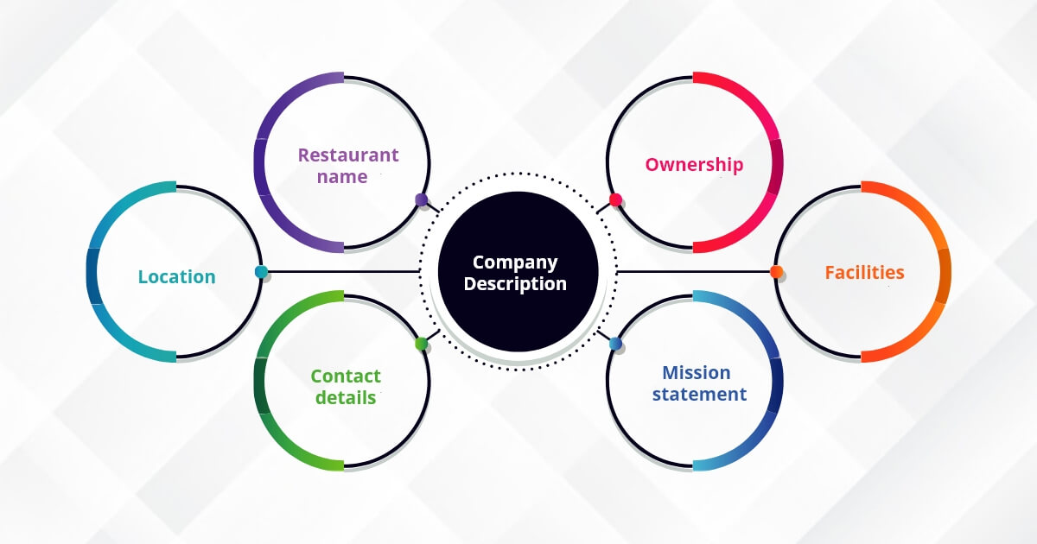
PROCESS
Follow all the preparation steps for successful Restaurant business.
Connect to the people Socially and locally to get the good services for business.
Develop restaurant’s marketing strategies.

Slide 6
Analysis
Creative Banner
Restaurant name
Market Analysis
Target Market
Competitive Analysis
Financial Analysis
Investment plan
Estimated Profit and loss
Location analysis
All the relevant contact information.
Brand Logo
Cashflow
Operational Plan Analysis
Menu
Staff
Market Overview
Marketing
External Help
Accountant
Restaurant Design
Suppliers
Supplier
Designer

Slide 7




SHARE
Seek out friends and family with relevant experience.
Evaluate financial availability and ask for support in affordable ways.
Document the funding with stakeholders companies.
Outline your business clearly with your well connected people.

Slide 8


ACT
After successfully completing above steps we can open an Indian Restaurant
Grand Opening Template Poster.
Apply marketing strategy to persuade the customers.
Promote the soft opening with posters and social media coverage.

Slide 9
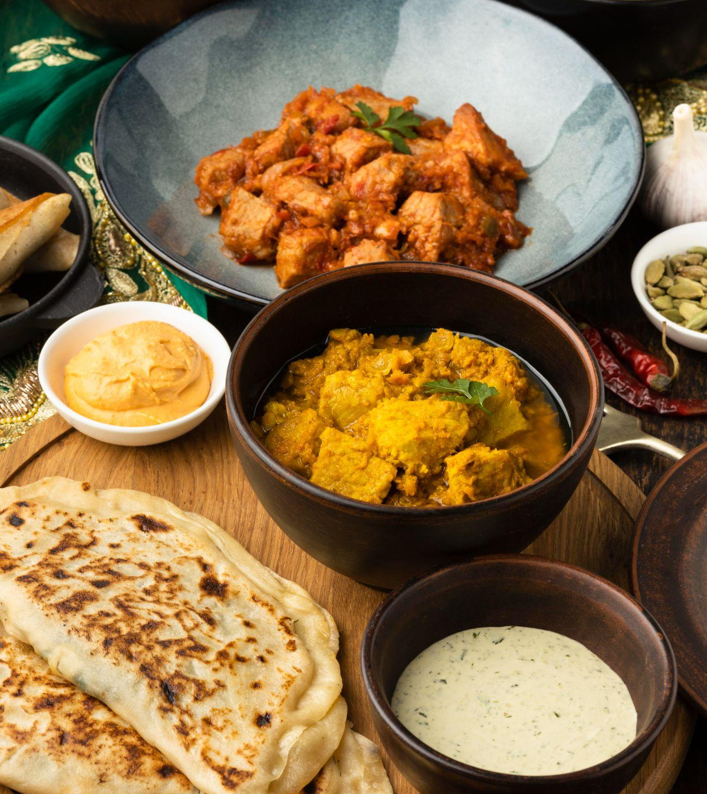
Thanks
Do you have any questions?
shilpisoni2022@gmail.com
+91 8218313790

